Slide 1
Case Study:
NLP Text Classification using Clustering technique
A Report By Nitika Goel

Slide 2
The problem
Problem statement
Our client, an Indian Healthcare firm, wants us to analyse social media data for understanding their patients’ concerns. Driving a Natural Language Processing (NLP) solutions, we are expected to cleanse and cluster social media data obtained from their facebook page for text mining and deriving meaning from that data. You are expected to identify noise elements that are not relevant for NLP and remove them (for example, stop-words, special characters, etc.) from the given data set and then cluster the data determining key topics that are discussed on the facebook page – for example, a creative topic modelling and or word cloud based solution.

Slide 3
Challenges deep-dive
Challenge 1
Challenge 2
Challenge 3
Preprocessing Text Data
Using NLP technique to preprocess text data:
Tokenization
Stop word Removal
Stemming
Creating Word Cloud
Creating word cloud to visualize the text messages and finding most occurring words.
Implementing K-Means Algorithm
Forming n- clusters to classify the Comment messages into the respective cluster.

Slide 4
Approach
The given Case study is a Unsupervised Machine Learning Problem. So, it doesn’t have target variable (labels).
By using NLP technique, try to preprocess, visualize and classify the message to the right cluster.

Slide 5
Implementation

Slide 6
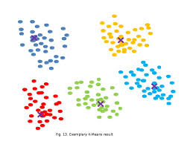
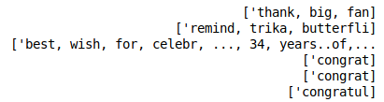

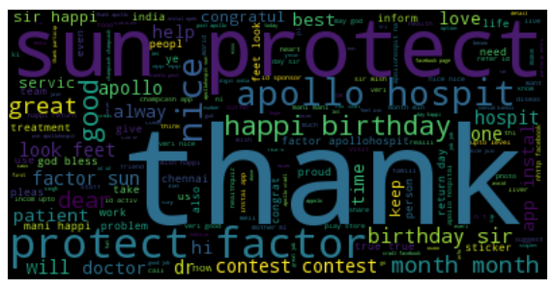

Creating DataFrame
Removing unicode characters
Preprocessing and Cleaning
Visualizing using word Cloud
K-Means Clustering

Slide 7

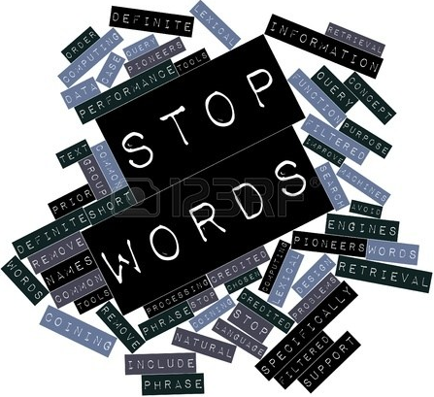

PREPROCESSING
TOKENIZATION : It breaks unstructured data, text, into chunks of information which can be counted as discrete elements
STOP WORD REMOVAL : Certain parts of English speech, like conjunctions (“for”, “or”) or the word “the” are meaningless to a topic model.These terms are called stop words and need to be removed from our token list.
STEMMING : Used to reduce topically similar words to their root. Porter stemmer returns the string parameter in stemmed form.

Slide 8
Removing the unicode b’ from the dataset
Removing hex code which were representing the emojis in text message.
Creating Count Vectorizer
Clustering the Model
Major Difficulties Faced

Slide 9
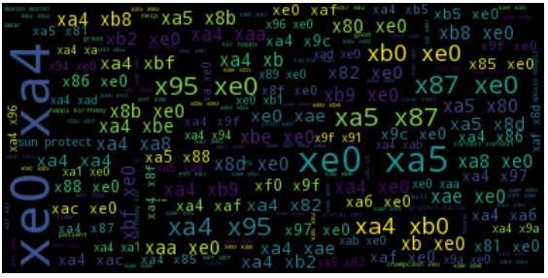
Word Cloud
Before Removing hex code
Maximum text was containing hex code which was representing the special character i.e. Emoji. So had to remove all these characters to make sense out of the given text data

Slide 10
Word Cloud After Removing Hex code
It shows that maximum occurring word in text data set is Thanks followed by protect , factor, apollo hospital etc.

Slide 11
Clustering the Text data using K-means Algorithm
This is one of the easiest and appropriate model while dealing with unlabelled data.
k-means clustering aims to partition ‘n’ observations into ‘k’ clusters in which each observation belongs to the cluster with the nearest mean, serving as a prototype of the cluster.

Slide 12
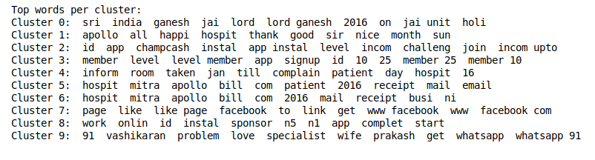
Clusters Formed

Slide 13
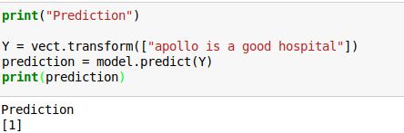
Let’s Make a Prediction
The given sentence belongs to 1st cluster that means our model is performing decently well.

Slide 14
How we can improve the model?
We can use other unsupervised learning algorithms like KN neighbours which will calculate pairwise distance and hence assign the sentence accordingly.
We can improve the accuracy by using hyperparameter tuning technique.
We can make a dictionary for removing more stop words
Use other nltk tokenizers and setting parameters to improve model accuracy.

Slide 15
